Slide 1

Software Design and Analysis Interaction Diagrams Sequence Diagram & Communication Diagram
Department of Computer Science
National University of Computer and Emerging Sciences

Slide 2
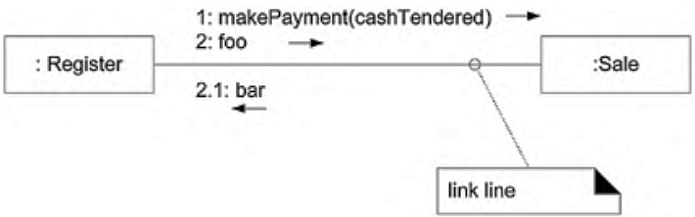
Communication Diagram
Basic Communication Diagram Notation:
Links
A link is a connection path between two objects. It indicates some form of navigation between the objects.
More formally, a link is an instance of an association.
For example: there is a link or path of navigation from a Register to a Sale, along which messages may flow, such as the makePayment message.

Slide 3
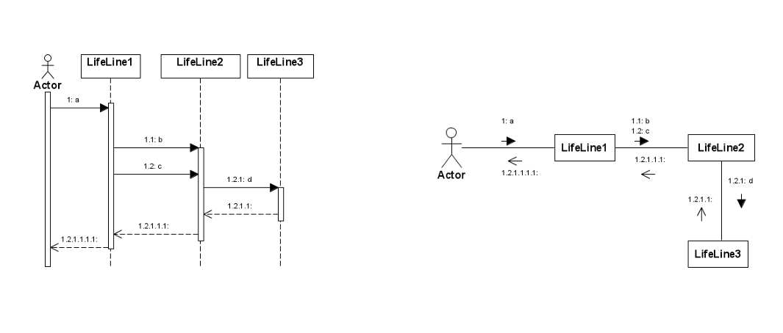

Slide 4
Communication Diagram
Note: Note that multiple messages, and messages both ways, flow along the same single link.
There isn't one link line per message; all messages flow on the same line, which is like a road allowing two-way message traffic.

Slide 5
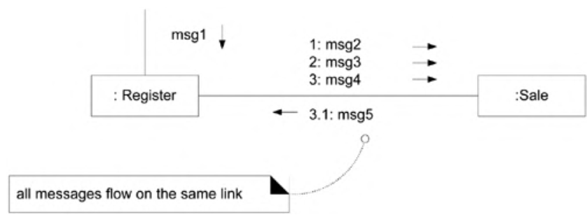
Communication Diagram
Basic Notation:
Messages
Each message between objects is represented with a message expression and small arrow indicating the direction of the message.
Many messages may flow along this link.
A sequence number is added to show the sequential order of messages in the current thread of control.

Slide 6
Communication Diagram
Guideline Don't number the starting message. It's legal to do so, but simplifies the overall numbering if you don't.

Slide 7
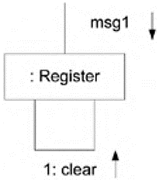
Communication Diagram
Basic Notation:
Messages to "self" or "this“
A message can be sent from an object to itself.
This is illustrated by a link to itself, with messages flowing along the link.

Slide 8
Communication Diagram
Basic Notation:
Creation of Instances
Any message can be used to create an instance, but the convention in the UML is to use a message named create for this purpose (some use new).
If another (less obvious) message name is used, the message may be annotated with a UML stereotype, like so: «create».
The create message may include parameters, indicating the passing of initial values. This indicates, for example, a constructor call with parameters in Java.
Furthermore, the UML tagged value {new} may optionally be added to the lifeline box to highlight the creation.
Tagged values are a flexible extension mechanism in the UML to add semantically meaningful information to a UML element.

Slide 9
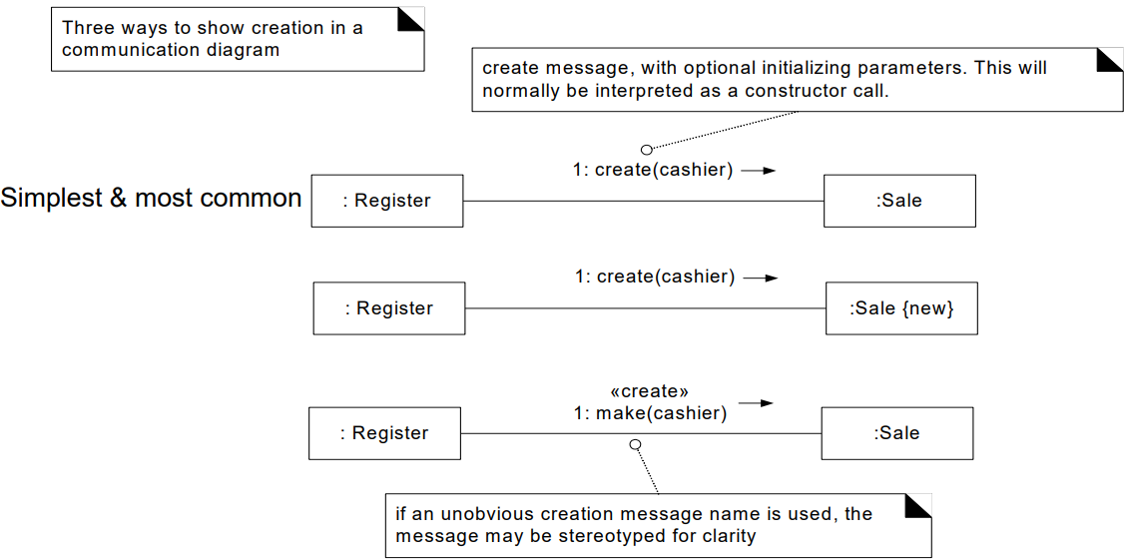
Communication Diagram
Creation of Instances

Slide 10
Communication Diagram
Basic Notation:
Message Number Sequencing
The order of messages is illustrated with sequence numbers. The numbering scheme is: The first message is not numbered. Thus, msg1 is unnumbered.
The order and nesting of subsequent messages is shown with a legal numbering scheme in which nested messages have a number appended to them.
You denote nesting by prepending the incoming message number to the outgoing message number.

Slide 11
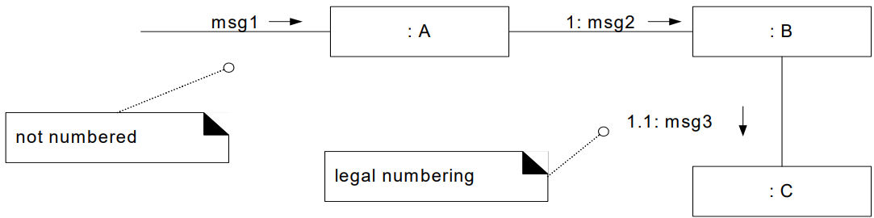
Communication Diagram
Message Number Sequencing

Slide 12
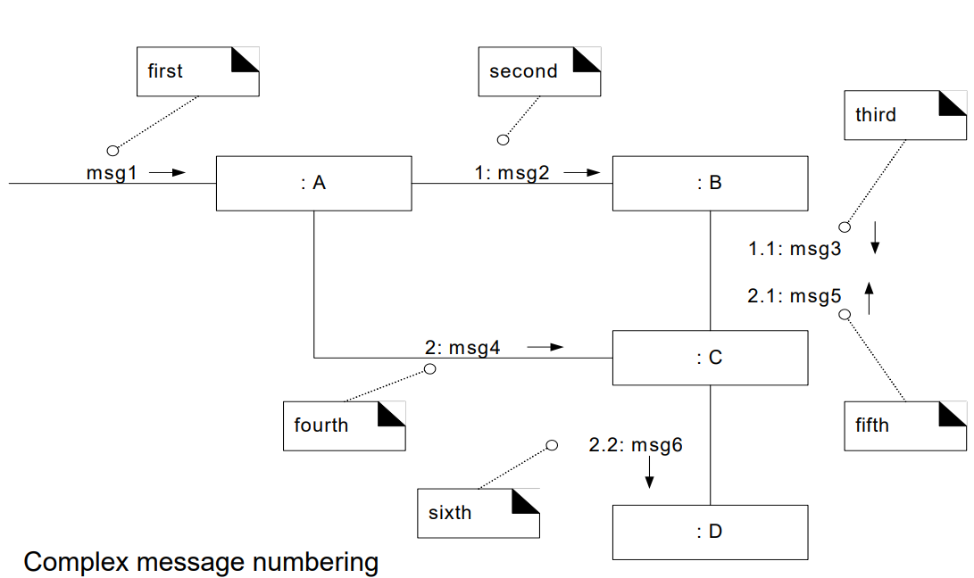
Communication Diagram
Message Number Sequencing

Slide 13
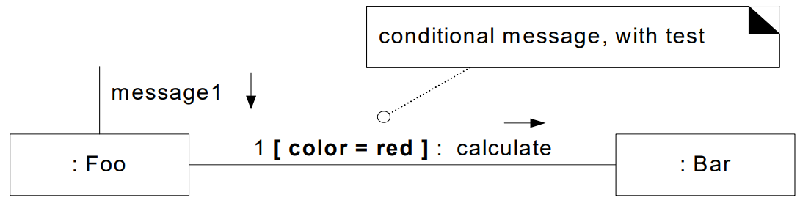
Communication Diagram
Basic Notation:
Conditional Messages
You show a conditional message by following a sequence number with a conditional clause in square brackets, similar to an iteration clause.
The message is only sent if the clause evaluates to true. .

Slide 14
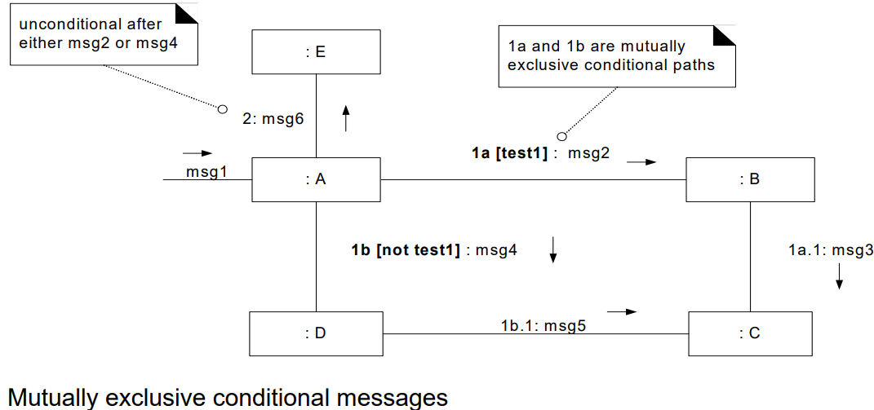
Communication Diagram
Basic Notation:
Mutually Exclusive Conditional Paths
The example in below illustrates the sequence numbers with mutually exclusive conditional paths.

Slide 15
Communication Diagram
Basic Notation:
Mutually Exclusive Conditional Paths
In this case we must modify the sequence expressions with a conditional path letter. The first letter used is a by convention.
It states that either 1a or 1b could execute after msg1.
Both are sequence number 1 since either could be the first internal message. Note that subsequent nested messages are still consistently prepended with their outer message sequence.
Thus 1b.1 is nested message within 1b.

Slide 16
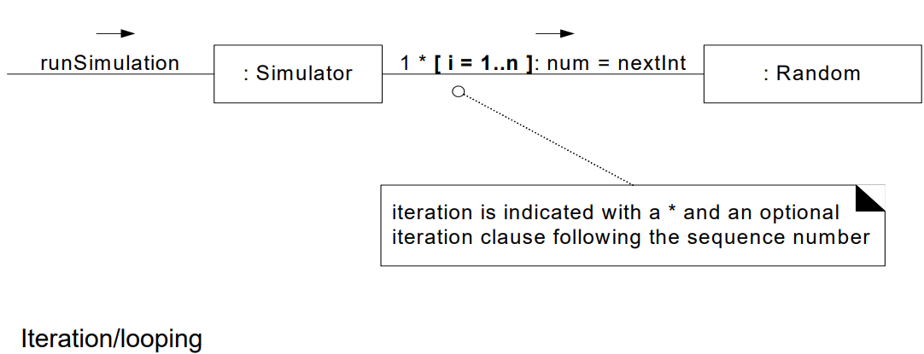
Communication Diagram
Basic Notation:
Iteration

Slide 17
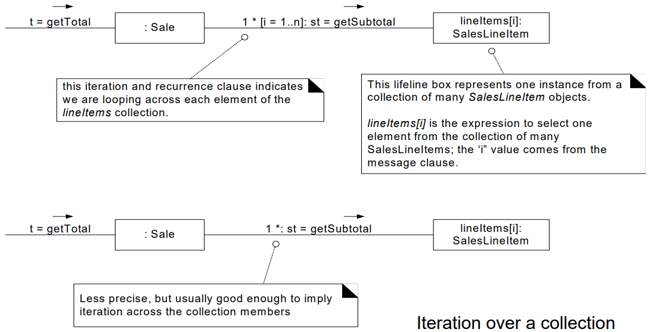
Communication Diagram
Basic Notations:
Iteration Over a Collection

Slide 18
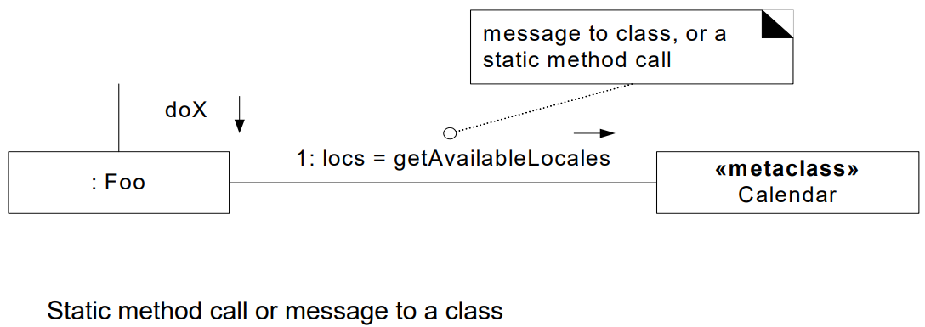
Communication Diagram
Messages to a Classes to Invoke Static (Class) Methods

Slide 19
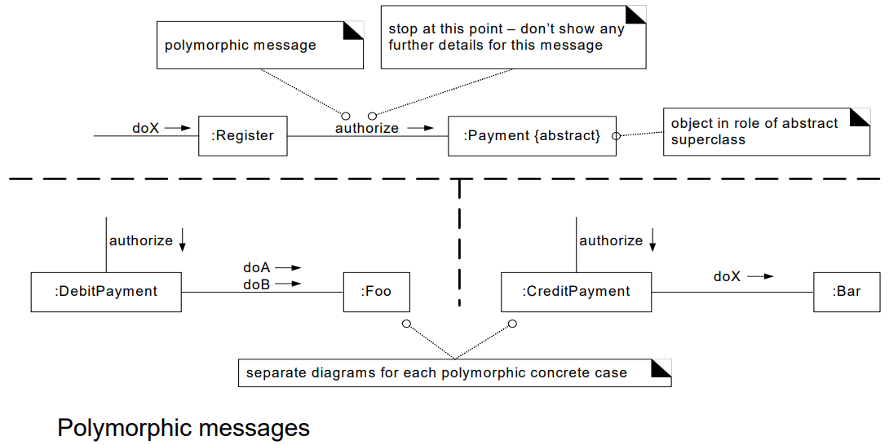
Communication Diagram

Slide 20
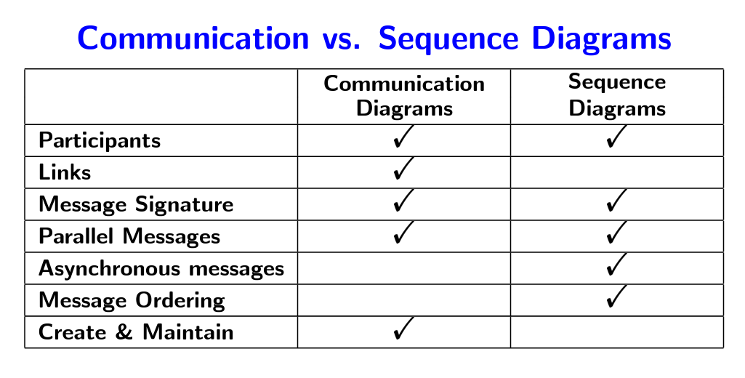

Slide 21
Draw a Communication Diagram
Let's assume changing the channel of your television using a remote control. The TV viewer starts the entire process. The use of the remote which will then interact with the TV. Let's assume the TV is already on and the TV viewer wants to change her channel. The first thing that happens is the TV viewer presses the numbers on the remote to tell it which channel to go to. The remote then sends a new message to the television to change the channel to number and TV will display the desired channel. If TV viewer is unsure what channel to go to and would like to surf the channels until they find a channel they like The TV viewer is going to press the up or down arrow on the remote to browse through the channels. This sends a message to the remote. The remote will then send a message to the TV with this action. Just like in the initial sequence, the TV changes the channel and displays that to the TV viewer.

Slide 22
End of Lecture Any Question ?

